Slide 1
Software Project Management activity planning
Dr. D Evangelin geetha
Associate professor
Department of master of computer applications
Ramaiah institute of technology
Bangalore - 560054

Slide 2
Activity planning
Learning Objectives
  Produce an activity plan
  Estimate the overall duration of a project.
  Be able to use different scheduling techniques.
  Determine the critical path and critical activities for a project.

Slide 3
Project Plan
A detailed plan for a project should include:
  Estimate of effort.
    For the project as a whole.
    For each activity.
  Estimate of schedule.
    For the project as a whole.
    For each activity.

Slide 4
Project Plan
Planning will enable us to:
  Ensure availability of resources when required.
  Produce a detailed schedule showing which staff carry out each activity.
  Avoid different activities competing for the same resources at the same time.
  Produce a detailed plan against which actual achievement may be measured.
  Produce a timed “cash flow forecast”.
  Re-plan the project during its life to correct drift from target.

Slide 5
Project Plan
A plan must be stated as a set of targets.
  The activity plan provides a target start and a target completion date for each activity.
  Ensuring that each activity produces a tangible product or deliverable will make monitoring the project’s progress easy. Why ?
  As the project progresses it is unlikely that everything will go according to plan.

Slide 6
Project Plan
Most of the project management job will be to:
  Recognize when something goes wrong.
  Identify its causes.
  Revise the plan to mitigate its effect.

Slide 7
Objectives of Activity planning
In addition to providing project and resource schedules.
  Feasibility assessment.
    Is the project possible within
      The required timescale and
      Resource constraints.

Slide 8
Objectives of Activity planning
For a project that has been estimated to require one person working 2 years (24 months), is it feasible to complete it within 3 months if 8 people (24/3) work on it ?
It depends on the availability of staff. Degree of which activities can be done in parallel.

Slide 9
Objectives of Activity planning
Resource allocation.
  What are the most effective ways of allocating resources?
  When should the resources be available?
Detailed costing.
  How much will the project cost?
  When is expenditure likely to take place?

Slide 10
Objectives of Activity planning
Motivation
  Providing targets.
  Measuring achievements against targets is a good way of motivating staff.
  It is also useful to involve the staff in setting targets.
Coordination.
  When do staff in different departments need to be available to work on a particular project?
  When do staff need to be transferred between projects?

Slide 11
Duration Versus Quality
One effective way of shortening project duration is:
  Carrying out activities in parallel.
  It is not possible to undertake all activities at the same time. Why ?
  Precedence requirements. (activities)and
  Resources constraints

Slide 12
Duration Versus Quality
One effective way of shortening project duration is:
  If we try to relax precedence constraints it is up to us to take care of the potential effects on the product quality.
    e.g. allow a coding activity to commence before a design activity is completed.

Slide 13
When to Plan
Planning is an on-going process of refinement
Feasibility study and project start-up:
  Estimate time and the risks of not achieving the target nor keeping it within budget
After the feasibility study:
  Produce activity plans for ensuring resource availability and cash flow control.

Slide 14
When to Plan
Throughout the whole project:
  we need to monitor the project and revise our plan, if there is any drift that prevents the project from being completed on time and within budget.

Slide 15
Project Schedule
Creating a project schedule comprises four steps:
  Step 1: Decide what activities to be carried and in what order.
    Based on that, we construct an ideal activity plan.
    An ideal activity plan is a plan where there are no constraints on the resources.

Slide 16
Project Schedule
Step 2: Activity risk analysis.
  This might suggest alterations to the ideal activity plan and implications on resource allocation.
Step 3: Resource allocation.
  The availability of resources may place constraints on when certain activities can be carried out.
  The ideal plan might need to be adapted accordingly.

Slide 17
Project Schedule
Step 4: Schedule production which contains:
  Start date for each activity.
  End date for each activity.
  Resource requirement statement for each activity.

Slide 18
Projects Versus Activities
A project:
  is composed of a number of related activities.
  may start when at least one of its activities is ready to start.
  will be completed when all of its activities have been completed.

Slide 19
Projects Versus Activities
An activity:
  must have a clear start and a clear stop
  resources must be for exactable.
  should have a duration that can be forecasted.
  may require that other activities be completed before they can begin.

Slide 20
Identifying Activities
There are three approaches to identify the activities or tasks that will make up the project:
  The activity-based approach.
  The product-based approach.
  The hybrid-based approach.

Slide 21
The activity-based approach
The activity based approach consists of creating a list of all activities that the project is thought to involve.
  How?
    Brainstorming session involving the whole project team
    The analysis of similar past projects.
    One useful way is to divide the projects into stages and think what activities might be required at each stage.
    One way of creating the activity or task list is to create WBS ( Work Breakdown Structure).

Slide 22
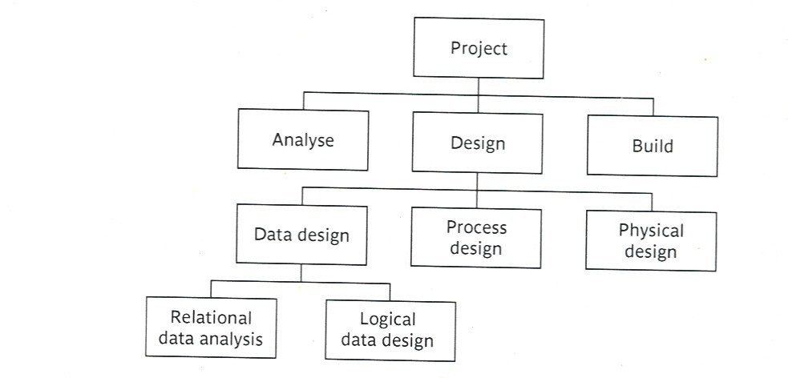
The activity-based approach

Slide 23
The activity-based approach
In WBS we:
  Identify the main (high level) tasks (activities) required to complete a project.
  Then break each of these down into a set of lower-level tasks.
When preparing the WBS:
  Too great depth should be avoided. Why ?
    Will result in a large number of tasks that will need to be managed.
  Too shallow structure should be avoided. Why ?
    This will provide insufficient detail for project control.

Slide 24
The activity-based approach
Advantages (WBS)
  More likely to obtain a task catalogue that is:
    Complete and Composed of non-overlapping tasks
    WBS represents a structure that can be refined as the project proceeds.
    Early in the project, It can start shallow. Developed as information becomes available e.g. during project analysis and specification phases.
    Once the project activities have been identified (whether using the WBS or not) they will need to be sequenced.

Slide 25
The product-based approach
It consists of producing a product breakdown structure PBS, and a product flow diagram PFD.
Product Breakdown Structure (PBS)
  To show how a system can be broken down into different products for development.
  Advantage: It is less likely to omit a product.

Slide 26
The product-based approach (cont’d)
  Product Flow Diagram (PFD)
    Once a product breakdown structure has been created, work can then begin on creating a product flow diagram which identifies the order of precedence of products and will typically include multiple and complex parallel paths.

Slide 27
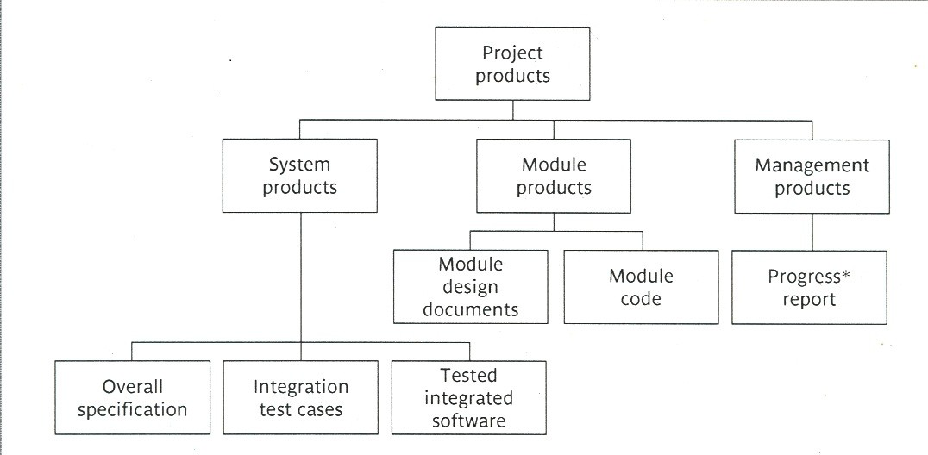
PBS

Slide 28
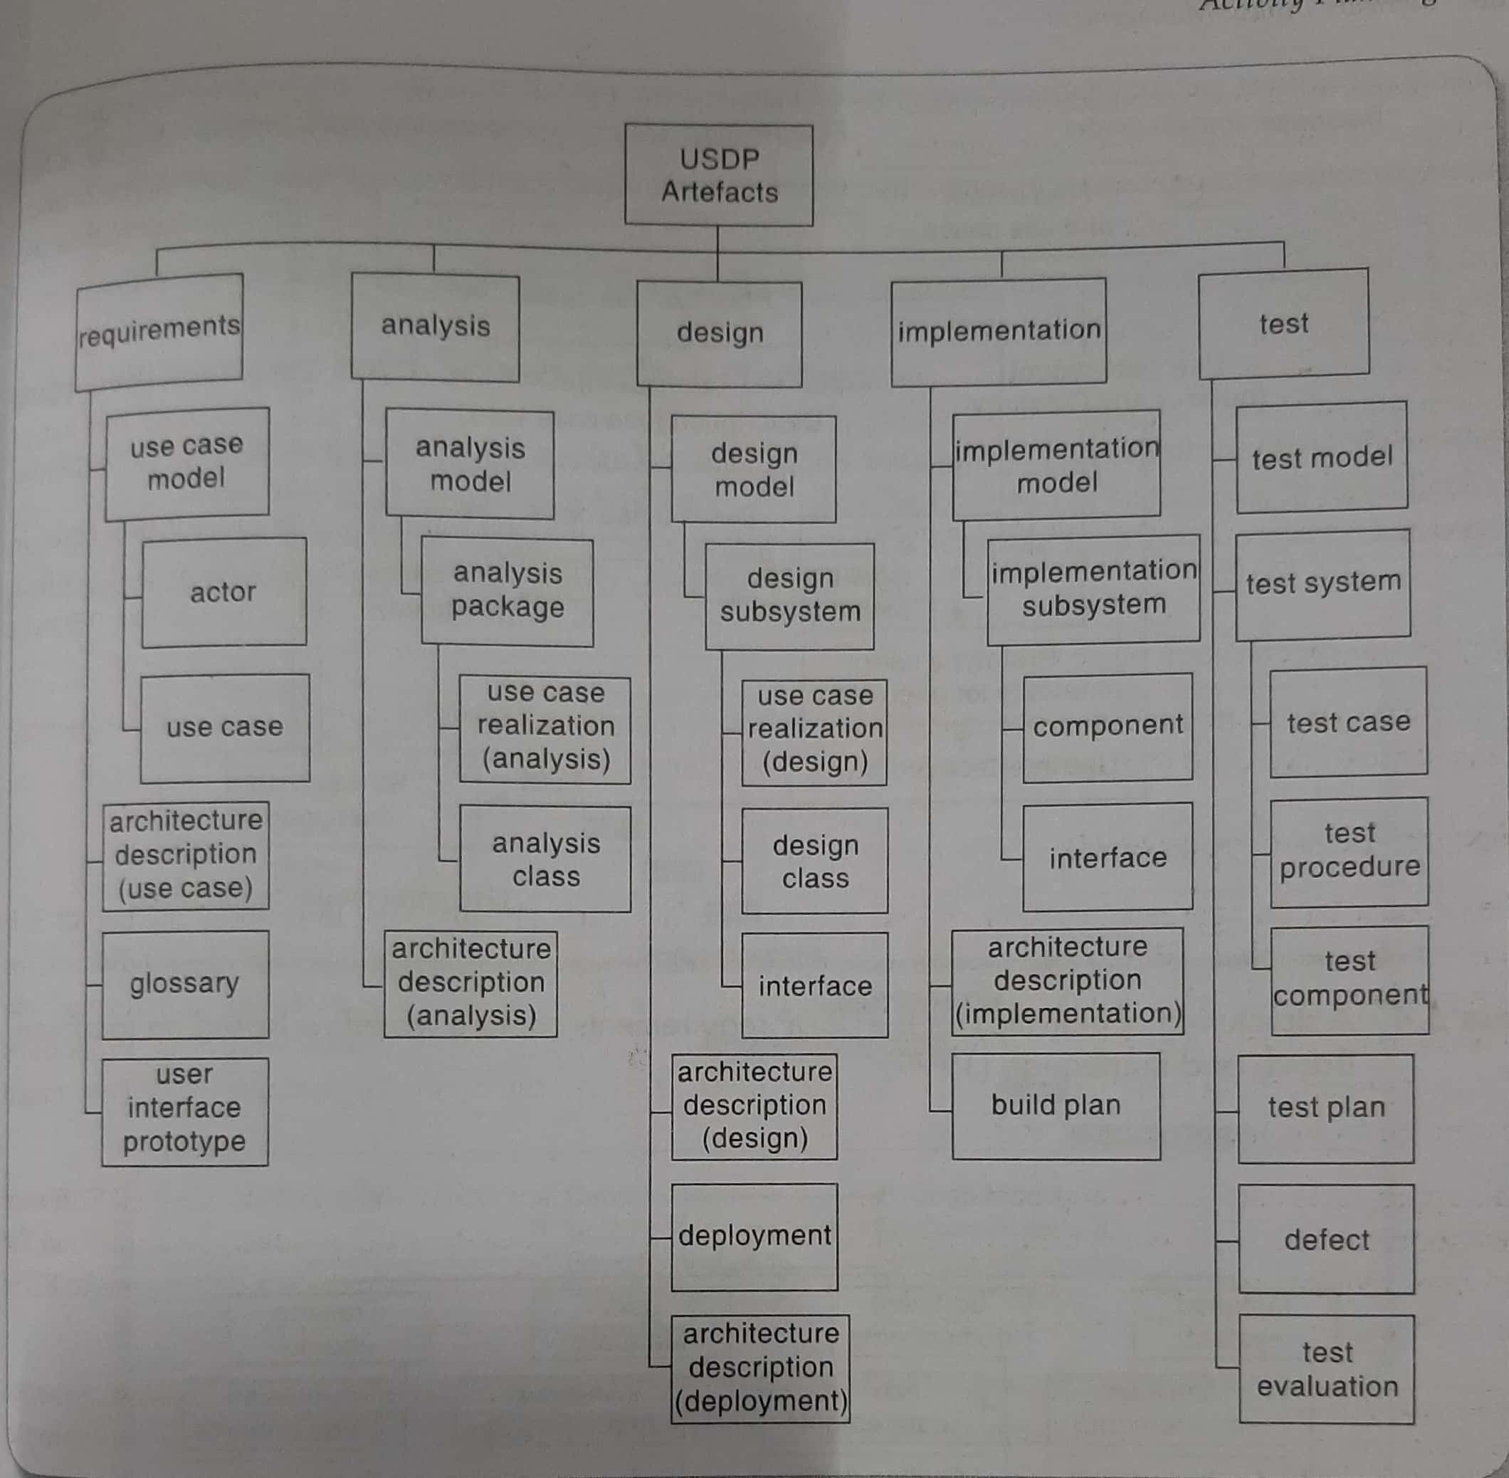
The product-based approach

Slide 29
The product-based approach
Product Flow Diagram (PFD)
  Indicates for each product, which products are required as ‘inputs’.
  Advantage: It is easily transformed into an ordered list of activities. How?
  By identifying the transformations that turn some products into others.

Slide 30
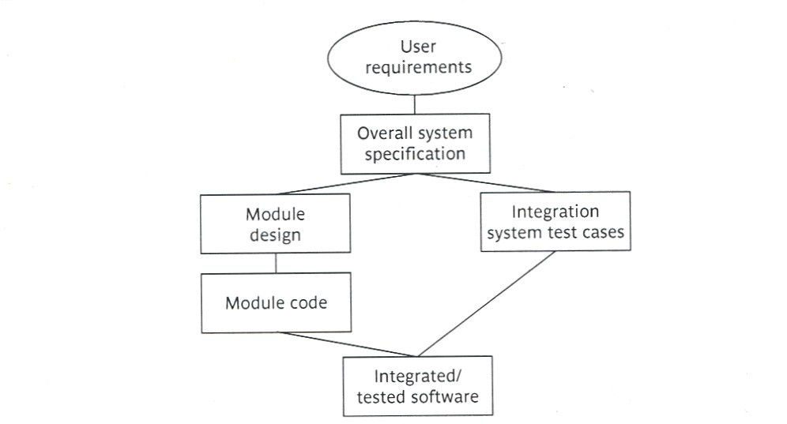
PFD

Slide 31
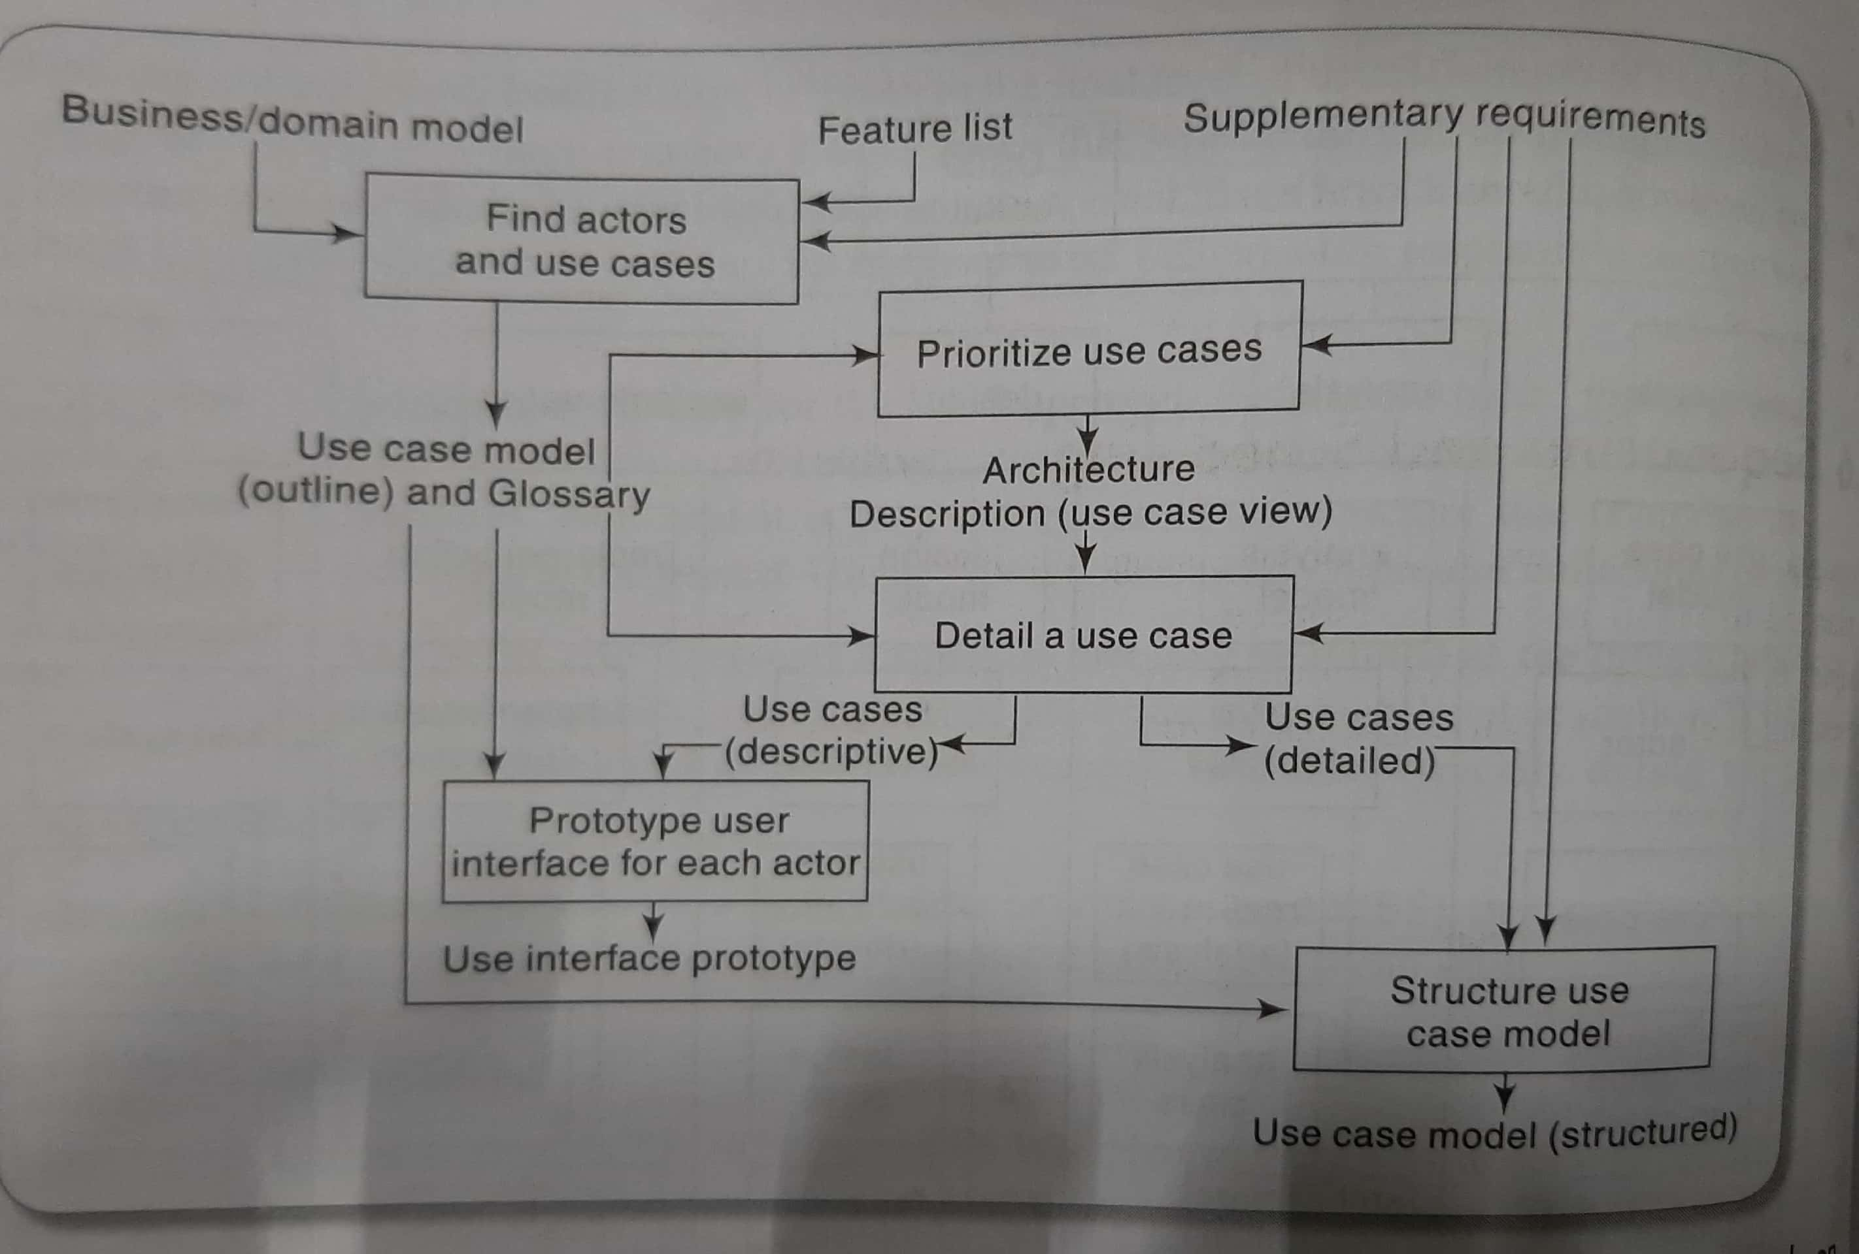
The product-based approach

Slide 32
The hybrid-based approach
A mix of the activity-based approach and the product- based approach.
Most commonly used approach.
The “ WBS” in the hybrid approach is based on:
  a list of the deliverable products of the project; and
  a list of activities for producing each product.

Slide 33
The hybrid-based approach
E.g. IBM
  Level 1: Project
  Level 2: Deliverables such as software, manuals, and training courses
  Level 3: Components, which are the key work items needed to produce deliverables, such as the modules and tests required to produce the system software
  Level 4: Work packages, which are major work items, or collections of related tasks, required to produce a component
  Level 5: Tasks, which are tasks that will normally be the responsibility of a single person.

Slide 34
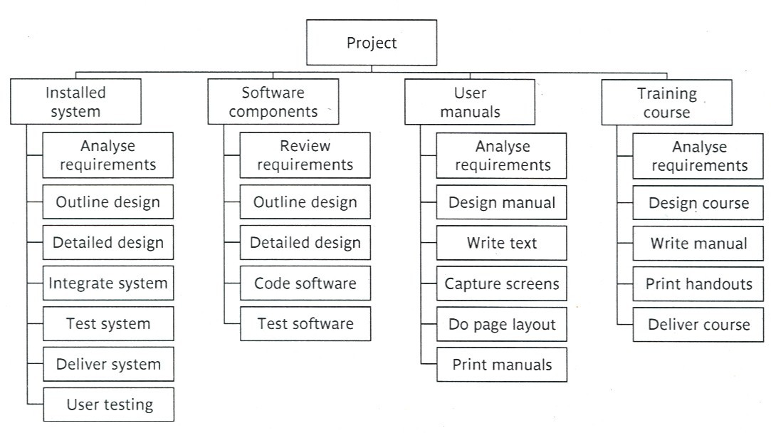
The hybrid-based approach
(cont’d)

Slide 35
Sequencing and Scheduling Activities
Schedule to indicate when each of the project’s activities is planned and what resources it will need
Based on the availability of the staff and how the activities allocated to them.

Slide 36
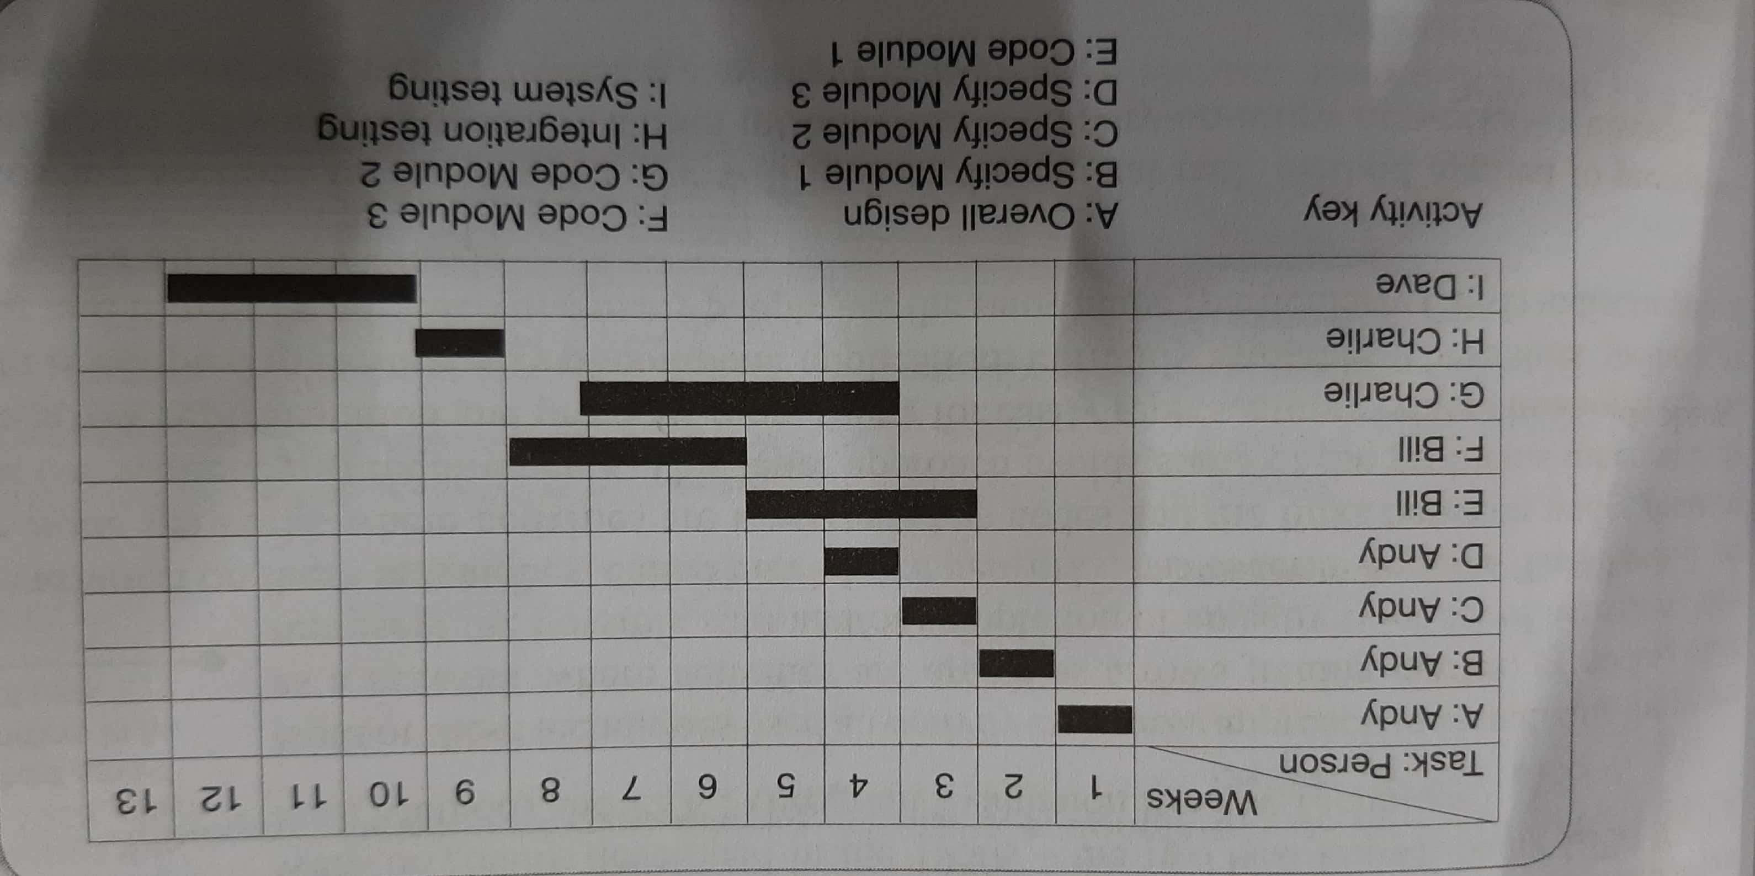

Slide 37
Sequencing and Scheduling Activities
It is better to separate out the two activities:
  To sequence the tasks according to their logical relationship
  To schedule them taking into account resources and other factors

Slide 38
Network Planning Models
Network Planning Models: are project scheduling techniques that model project activities and their relationships as a network.
  Activity-on-Arrow techniques:
    CPM (Critical Path Method).
    PERT (Program Evaluation Review Technique).
  Activity-on-Node techniques:
    Precedence Networks.
  These three methods are very similar and many people use CPM to refer to all of them.

Slide 39
Network Planning Models
Activity-on-Arrow techniques:
  Activities – arrows joining circles, or nodes
  Start and completion of an activity / set of activities – circles or nodes
  Activity-on-Node techniques:
  Activities – nodes
  Precedence requirements – links between the nodes

Slide 40
Activity-on-Node
Specify module A
Design module A
Code/test
module A
Specify module B
Design module B
Code/test
module B
Specify overall system
Check
Specification
Integrate/test system
Specify module C
Design module C
Code/test
module C
Specify module D
Design module D
Code/test
module D

Slide 41
Activity-on-Arrow
Specify
Design
Code/test
5
module A
module A
module A
Specify
Design
Code/test
Specify overall system
Check
Specification
6
Integrate/test
System
1
2
module B
3
4
module B
module B
9
10
Specify
Design
7
Code/test
module C
module C
module C
Specify
Design
Code/test
8
module D
module D
module D

Slide 42
Formulating a Network Model
The first stage in creating a network model is to represent the activities and their relationships as a graph

Slide 43
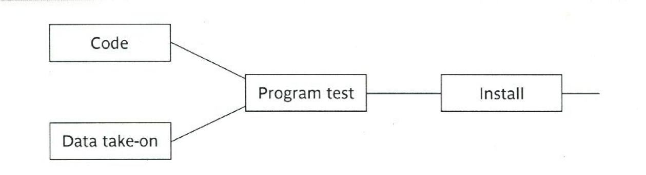
Precedence Networks
In the precedence networks:
  The nodes represent activities.
  The lines between nodes represent dependencies.

Slide 44
Precedence Networks
Rules and Conventions
A project network should have only one start node.
A project network should have only one end node.
A node has duration.
Links have no duration.
Precedents are referred to the immediate preceding activities.

Slide 45
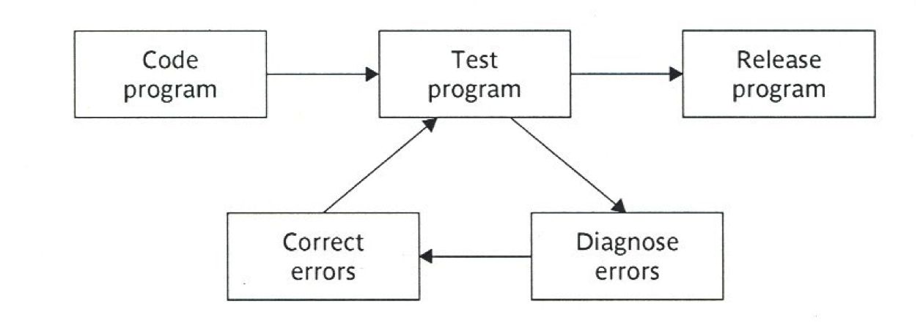
Precedence Networks
Rules and Conventions
Time moves from left to right.
A network may not contain loops.
A network should not contain dangles.

Slide 46
Precedence Networks
Loops can't be directly represented in a project network.
  If you know the number of times we expect to repeat a set of activities, then
  we can draw them in a sequence repeating them for the appropriate number of times.

Slide 47
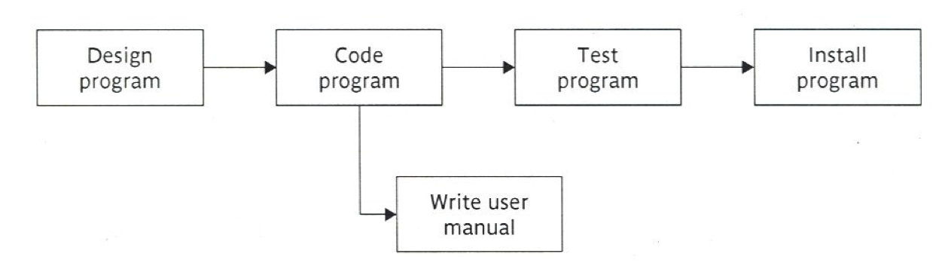
Precedence Networks
A dangle:
  Here what is meant by the diagram is: that the project will be finished once we “the program has been installed” and “the user manual is written”. “Write user manual” is a dangling activity.

Slide 48
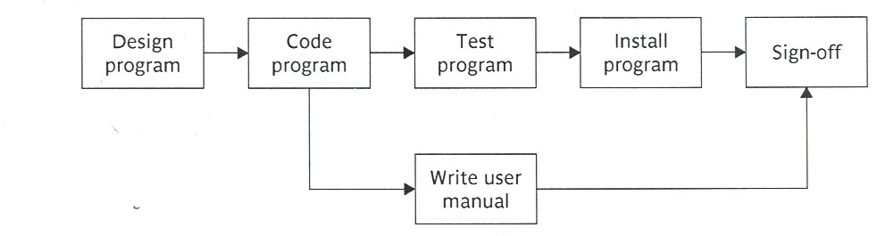
Precedence Networks
Resolving the dangle

Slide 49
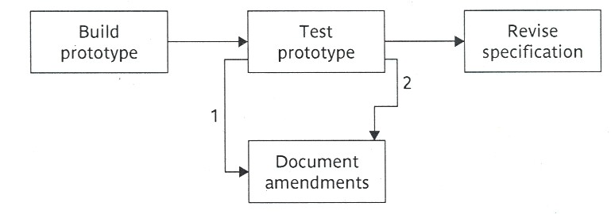
Representing Lagged Activities
Lag activities: are two activities that will be undertaken in parallel but there is a lag between them.
Here two activities will be undertaken at the same time with some lag between them.
“Document amendments” will start one day after “Test prototype” starts and finish two days after “Test prototype” ends.

Slide 50
Hammock Activities
Activities, in themselves have zero duration but are assumed to start at the same time as the first ‘hammocked activity and to end at the same time as the last one
Used to represent overhead costs or other resources that will be incurred or used at a constant rate over the duration of a set of activities

Slide 51
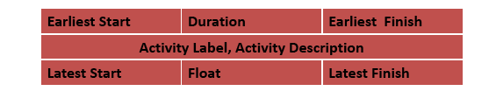
Labeling Conventions
There are a number of labeling conventions.
Label convention is a way of entering information on an activity-on-node network.
One labeling convention is the British Standard 4335.

Slide 52
Adding the Time Dimension
After we create the logical network model showing the activities and the interrelationships between those activities. We should think of when each activity will be undertaken.
The critical path approach is concerned with:
  Planning the project in a way that it will be completed as quickly as possible.
  Identifying the activities where a delay in their execution is likely to affect
    The overall end date of the project or
    Later activities start dates.

Slide 53
Adding the Time Dimension (cont’d)
For each activity we will estimate its duration.
The network is then analyzed by carrying out the forward pass and a backward pass.
The forward pass:
  Calculates the earliest dates at which activities may be started, finished
  Project completion time.
The backward pass:
  Calculates the latest dates at which activities may be started, finished, the float and
  The critical path.

Slide 54
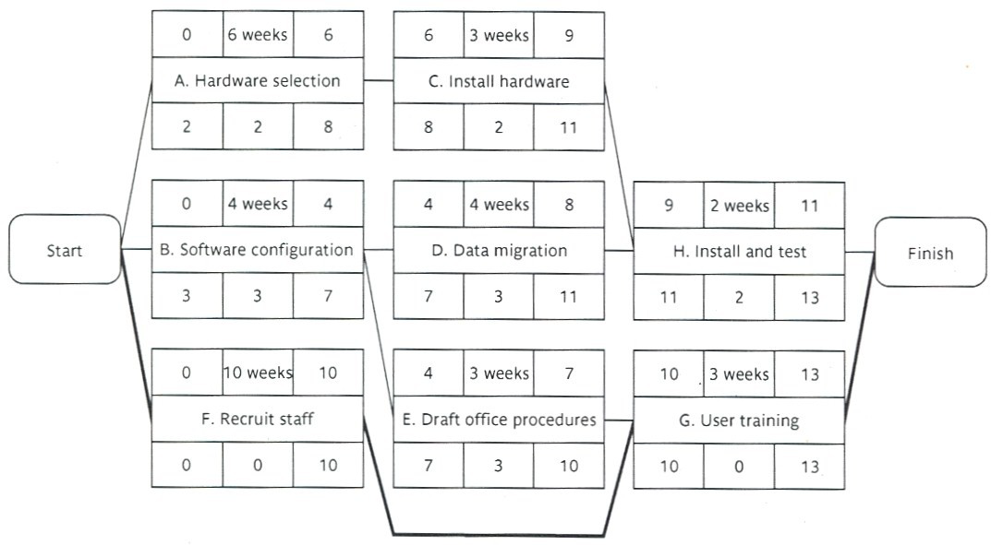
Example (cont’d)
The project duration=13 weeks

Slide 55
The Critical Path
There will be at least one critical path in the network.
The critical path defines the duration of the project.
Any delay to any of the activities on this critical path will result in a delay of the project completion.
Activity Float:
  Difference between the latest start and the earliest start or
  Difference between the latest finish and the earliest finish.
Activity Span:
  Difference between the latest finish and the earliest start.
  It is a measure of the maximum time allowable for the activity.

Slide 56
Example
What is the Activity Span for:
  Activity D: 11-4 =7 weeks
  Activity G: 13-10= 3 weeks

Slide 57
Critical Activities
They are those on the critical path.
Activities not on the critical path may become critical. How?
  As the project proceeds the activities may use some of their float.
    Periodic recalculation of the network is required.
As soon as activities on a particular path use up their float the activities will become critical.
Identifying critical activities is an important step in:
  Risk analysis.
  Resource allocation.
  Project monitoring.

Slide 58
Activity Float
Time allowed to delay an activity start.
3 different types:
  Total float (without affecting the completion of the project) it is the float recorded in the precedence network
= Latest start date – Earliest start date
  Free float (without affecting the next activity)
= Earliest start date of next activity – Earliest Finish date of activity(in question)
  Interfering float = (total float - free float)

Slide 59
Example
For Activity D
What is the total float?
  Total float= 3 w
What is the free float?
  Free float= ES(H)- EF(D)= 9 - 8=1 w
What is the interfering float?
  interfering float= 3 - 1=2 w

Slide 60
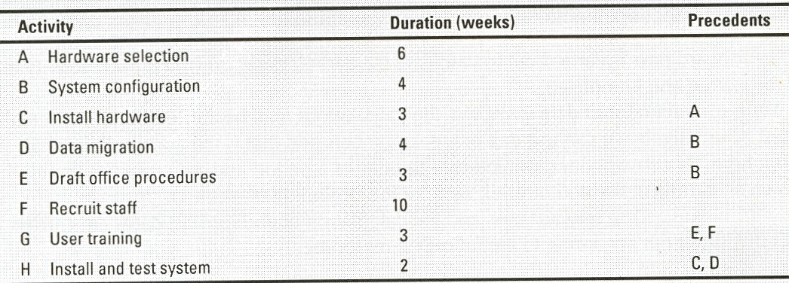
Example

Slide 61
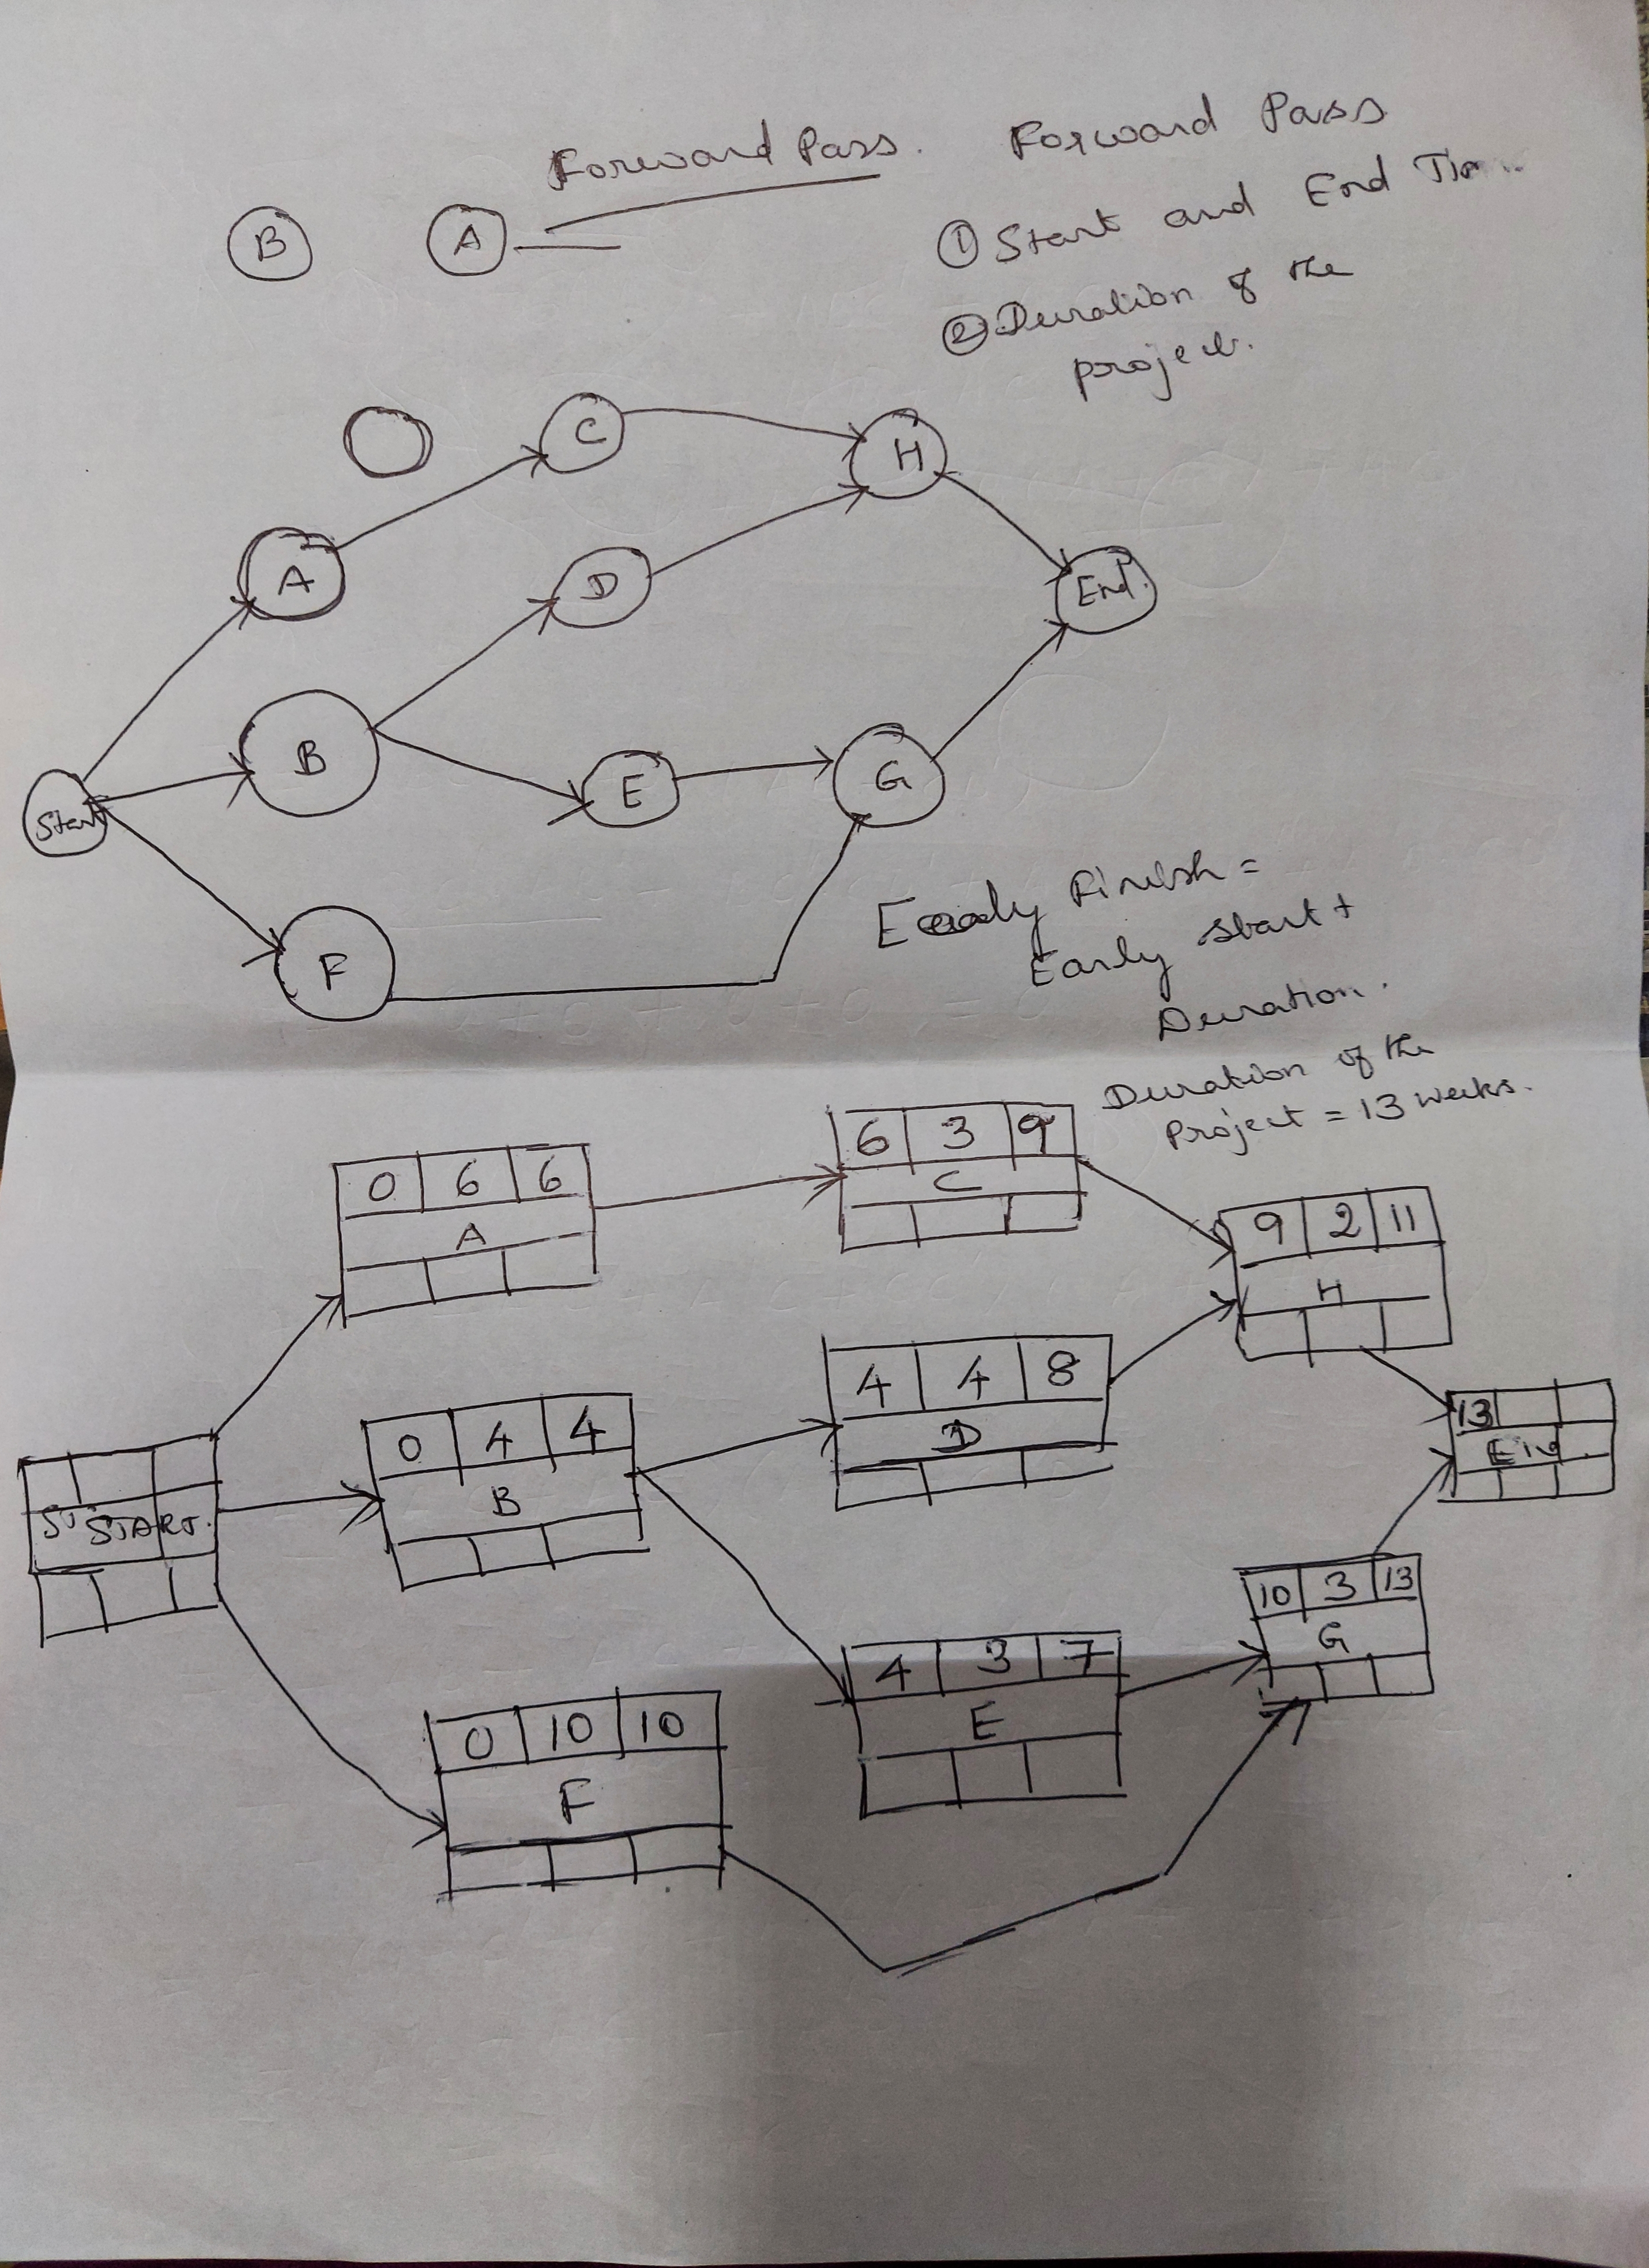

Slide 62
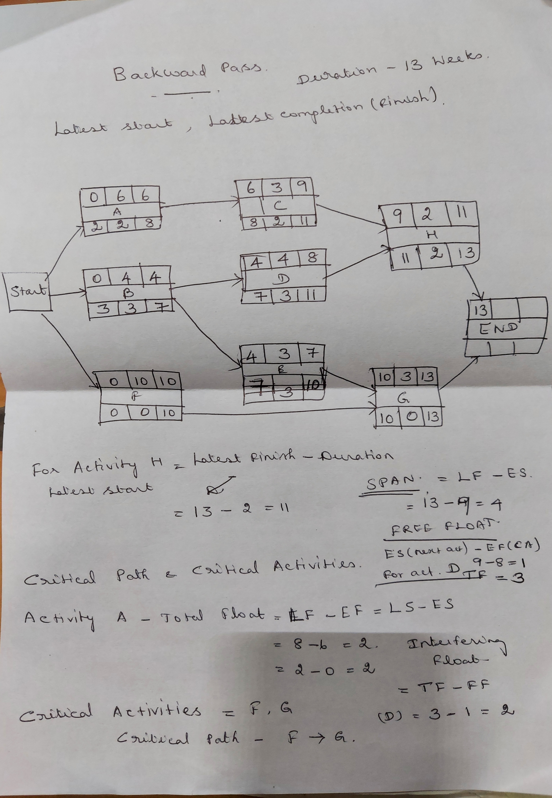

Slide 63
Shortening the Project Duration
If we want to bring forward the end date of the project, which activities should we try to reduce their durations?
  Critical activities.
How can we reduce the time duration for an activity?
    More resources.
    Working overtime.
    Additional staff
Suppose that the duration for activity F is shortened to 8 weeks, calculate the end date of the project.

Slide 64
Activity-On-Arrow Network‭ ‬
Links or arrows represent activities‭. ‬
Nodes represents events‭. ‬

Slide 65
Activity-On-Arrow Network (cont’d)‭ ‬
Rules and Conventions‭ ‬
A project network may have one start node‭. ‬
A project network may have only one end node‭. ‬
A link has duration‭. ‬
Nodes have no duration‭. ‬
  Nodes are events‭. ‬
    The source node‭. ‬
    ‬The sink node‭. ‬
    ‬The intermediate nodes‭. ‬
‬

Slide 66
Activity-On-Arrow Network (cont’d)‭ ‬
Time moves from left to right‭. ‬
Nodes are numbered sequentially‭. ‬
A network may not contain Loops‭. ‬
A network may not contain dangles‭. ‬
    ‬‬

Slide 67
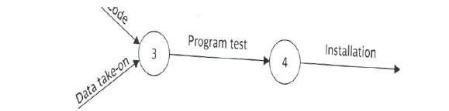
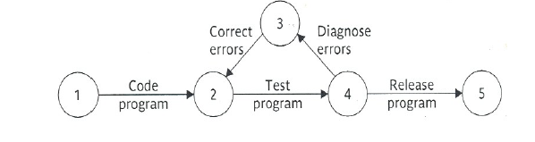
Sequential numbering‭ ‬
A loop: A network may not contain Loops‭.

Slide 68
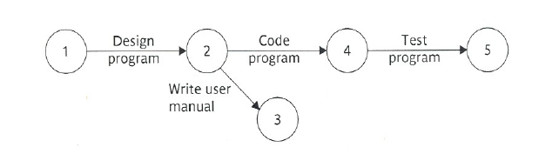
A Dangle‭: A network may not contain dangles‭. ‬

Slide 69
Dummy Activities‭ ‬
A Dummy activity is an imaginary activity. It does not exist in the Project activities. It is used in the network diagram to show dependency relationship or connectivity between two or more activities. It is represented by a dotted arrow.

Slide 70
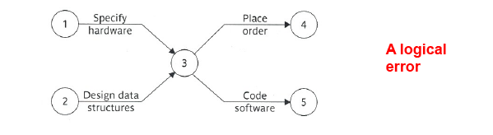
Dummy Activities‭ ‬
Suppose that in a project‭,
Before you can start‭ “coding the software” ‬you need to‭: ‬
  “Specify the hardware”
  “Design data structures”.
Before placing an order you only need to‭: ‬
  “Specify the hardware” ‬

Slide 71
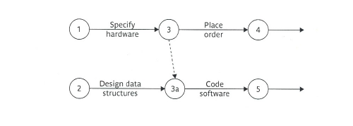
Dummy Activities‭ ‬
Resolving the error using a dummy activity‭. ‬
Dummy activities‭: ‬
  Are used to aid in the layout of network drawings‭. ‬
  ‬

Slide 72
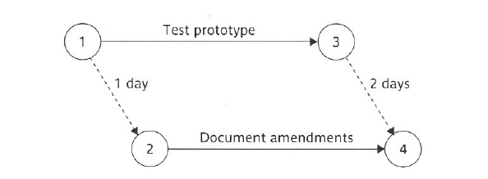
Lagged Activities‭ ‬
We represent lagged activities with a pair of dummy activities‭.
  ‬
  ‬

Slide 73
Activity Labelling
Event Number
Earliest date
Latest date
Slack

Slide 74
Network Analysis
Forward Pass
Backward Pass
Calculating Slack
Identifying critical path

Slide 76
2r
2r
C=3
6
Latest date
9
Latest date
A=6
Slack
Slack
1
B=4
0
Latest date
3
Slack
4
Latest date
Slack
F=10
4
10
Latest date
Slack

Slide 77
